Slide 1
Relay Instructions
Latch-Unlatch
© 2014 John Sefcovic.

Slide 2
Relay Ladder Logic
OUTPUT LATCH (OTL)
TAG
-( L )-
The Output Latch (OTL) instruction will be set to a LOGIC '1' when there is a complete left to right path of true input instructions. Else, a logic '0' is stored in memory.
The output will remain SET or ON if the left to right continuity of the conditional inputs is lost.
Once the output is set to ON, it will remain ON even if the rung then goes false, a Latch Output is retentive.

Slide 3
Relay Ladder Logic
OUTPUT UNLATCH (OTU)
TAG
-( U )-
The Output Unlatch (OTL) instruction will RESET or turn OFF the output latch that has the same reference address as the output Unlatch instruction.
If both the Output Latch and Output Unlatch rungs are true, the effect will be that the output will never turn ON or will always be ON depending on which instruction is scanned first.

Slide 4
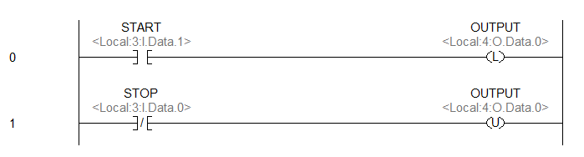
Relay Ladder Logic
Notice the Latch and Unlatch instruction have the same Tag.
When START transitions from False to True the OUTPUT turns On and will remain On when the pushbutton returns to False.
When STOP transitions from False to True the OUTPUT turns Off.
Note: the pushbutton is returned to False.

Slide 5
Relay Ladder Logic
The STOP pushbutton is wired Normally Closed.
When the STOP pushbutton is pressed to turn Off the Output the contact are apart (no voltage). An Examine Off is used to make the instruction True.

Slide 6
Relay Ladder Logic
Latch Instruction Advantages
Acts as “last state” output, if power is lost to the programmable controller, when power is restored the outputs are restored to the state they were in before power loss.
Rungs where the conditional input states are “pulsed” and not maintained for the entire duration of while the rung is to be true.
For “single step” function where conditional input states which makes the rung true are pulsed.
A “resume” when production is paused.
Notice the last three examples are a sub-functions of the “last state” capabilities of the instruction.

Slide 7

Relay Ladder Logic
Latch Instruction Disadvantages
All condition which will make the rung go false must be accounted for in the Unlatch Output rung.
Machine or process must have logic programmed to “reset”, cycling power will not turn off errant latched outputs.
Outputs which may need to be off before restarting machine or process must be accounted for in program logic.
USE LATCH – UNLATCH INSTRUCTIONS WITH CAUTION.

